Slide 1
Mini-project
A local wonder:
Railway Izhevsk- Balezino
Written by Arina Kasimova
Checked by I.M.Yakimova

Slide 2
Tasks:
a) Think about the place where you live.
b) Choose a man-made wonder near you.
c) Describe the wonder (Where? / When? / Why? / How?)

Slide 3
Udmurt Republic
Udmurtia is an amazing region with a long history, a multinational republic is inhabited by Udmurts, Russians, Tatars, Maris and others.
Udmurtia has a unique nature, special traditions and way of life, a mysterious land of myths and legends, where bright, yellow Italmas grows. It is the symbol of our republic.

Slide 4
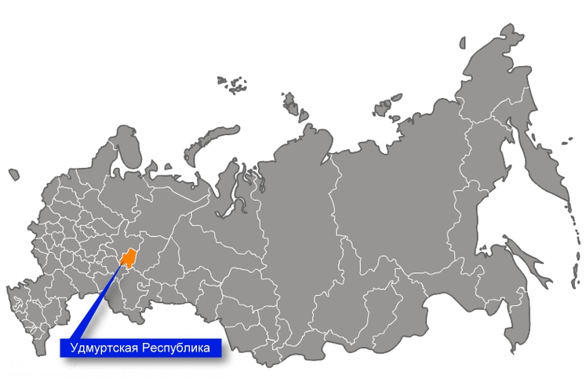
Udmurt Republic
Udmurtia is a subject of the Russian Federation.
Izhevsk is the capital of Udmurtia.

Slide 5
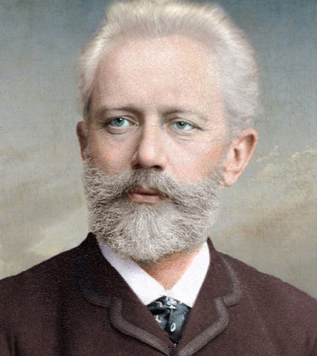
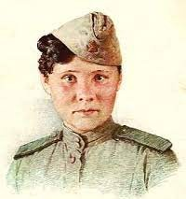
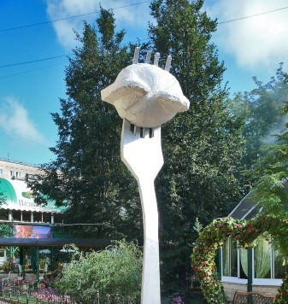
Udmurtia is the homeland for...
Composer P.I.Tchaikovsky
Hero of the USSR T.N.Baramzina
Kalashnikov assault rifle
Udmurt pelmeni

Slide 6
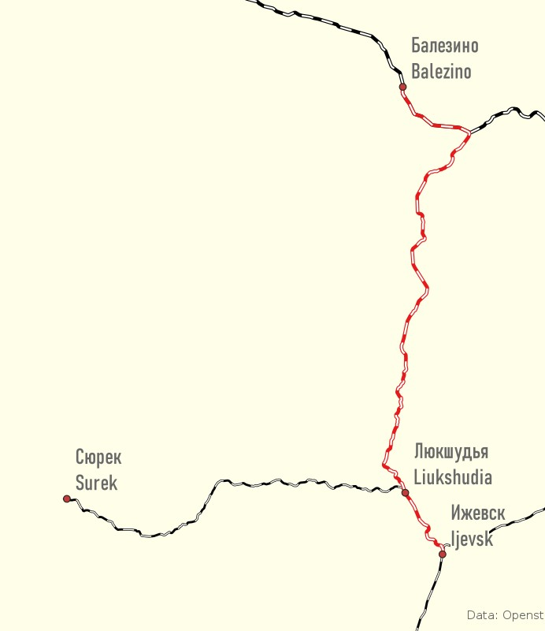
The railway Izhevsk-Balezino
The railway is a single-track railway, on the section Izhevsk - Balezino, with diesel traction in Udmurtia.
It is part of the Izhevsk branch of the Gorky Railway. The railway passes through the territory of the city of Izhevsk, Zavyalovsky, Yakshur-Bodyinsky, Igrinsky and Balezinsky areas of Udmurtia.

Slide 7
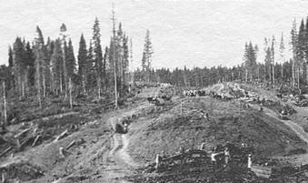
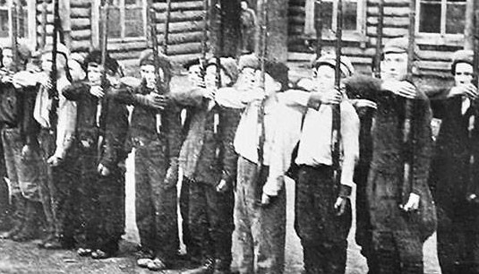
The railway Izhevsk-Balezino
The building of the railway began on January 1, 1942 during the Great Patriotic War.
In March, 1943, the labor movement was opened, and the construction was finally completed in 1944. In the period from 1943 til 1944, 1.6 million tons of cargo was transported by railway.

Slide 8
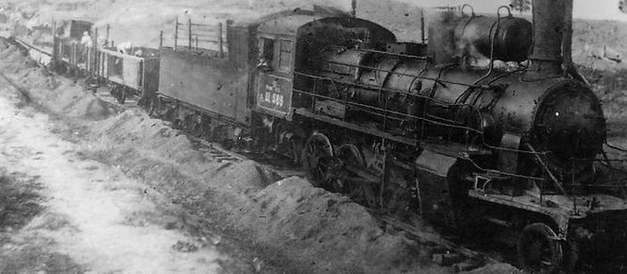
The railway Izhevsk-Balezino
The purpose of the building was to reduce the time of transporting coal and timber from the north to defense plants.

Slide 9
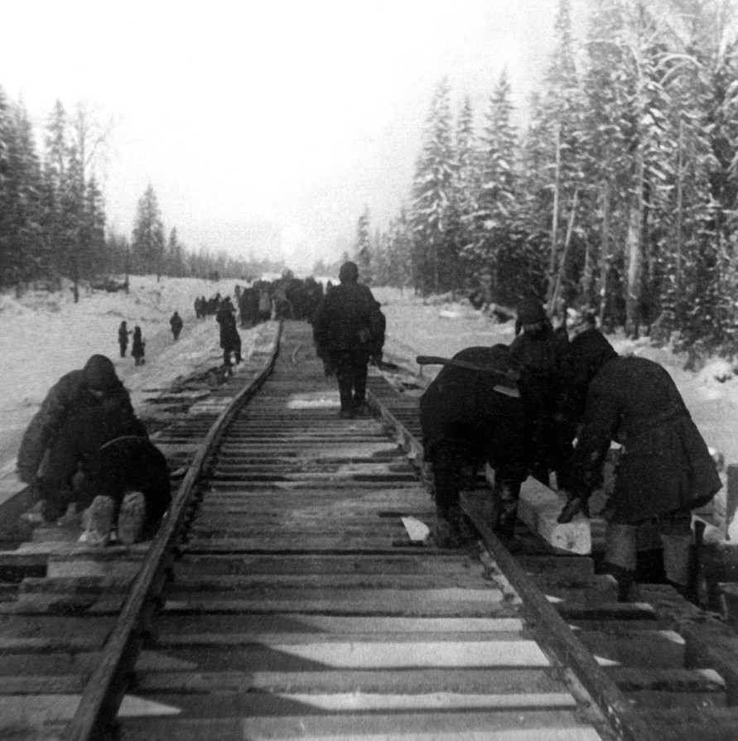
The railway Izhevsk-Balezino
By the beginning of the building, most of the men had been drafted into the army; the road was being built mainly by women and teenagers. Collective farmers were also involved in this construction. The district committees of the UASSR supplied with tools.
People had to work by the own hands in very difficult conditions.

Slide 10
The railway Izhevsk-Balezino
The memories of the builders
"… Ни днем, ни ночью не прекращалась работа. В 54- градусные морозы, в пургу и метели, под проливным осенним дождем десятки тысяч колхозников и колхозниц трудились на трассе, забывая о сне и отдыхе. У каждого было одно желание — работать так, как подобает гвардейцам тыла, быстрее построить дорогу, которая так необходима Родине…"

Slide 11
The memories of the builders
"… Поселились мы в огромном логу, вблизи от села.
Построили временное жильё — подобие землянок. В вырытые ямы поставили столбы, сверху накидали жердей и укрыли всё это хвойными лапами. Внутри выкопали нары и укрыли их так же, как и крышу… Работали весь световой день… Техники никакой не было, а работали за кусок хлеба… В бане ни разу не мылись… одежда и обувь превратились в лохмотья…"

Slide 12
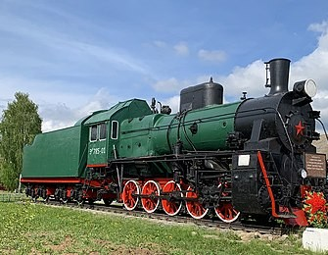
The railway Izhevsk-Balezino
Nowadays, one commuter train runs along this road: Izhevsk - Balezino, as well as passenger trains: Perm - Novorossiysk, Perm - Adler, Izhevsk
- St. Petersburg a n d some freight trains.
The photo shows a monument to the heroic builders of the railway at the station in Balezino.

